Slide 1
An Introduction to PDDL
CS4373: Artificial Intelligence Laboratory
A.Y. 2023-2024
Department of Computer Science and Engineering
National Institute of Technology Rourkela

Slide 2
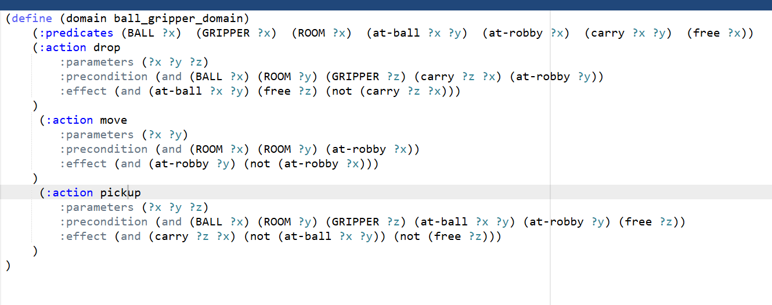
Domain

Slide 3
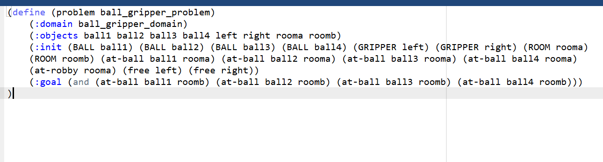
Problem

Slide 4
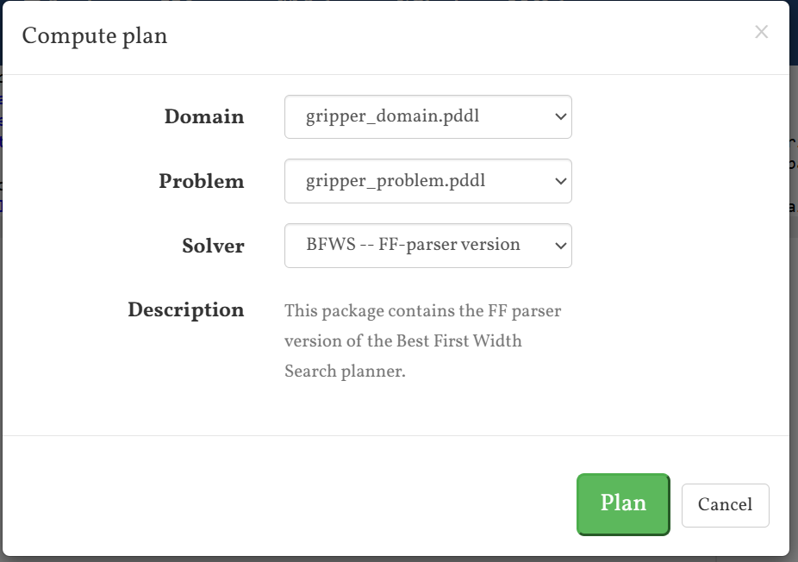



Solve

